Slide 1
ANALYTICAL METHODS Course Project

Slide 2
The Team

Slide 3


Teamwork: “Having somebody else you can blame it on”

Slide 4
The Problem

Slide 5

How do we help wine makers make the best wine?
“Without data, you’re just another person with an opinion”
- W. E. Deming
Examine physicochemical characteristics of various red wine samples and how they are related to their perceived quality ratings.
Use data-driven techniques to help uncover the holy grail of wine making.
The physicochemical characteristics of 1.6K samples of Vino Verde red wine from Portugal were studied to determine the key drivers of their quality ratings.

Slide 6
The Data

Slide 7
Dataset Description
Sl. No. | Variable | Variable Type | Description
1. | Fixed Acidity | Explanatory | Grams of tartaric acid per dm³ of sample
2. | Volatile Acidity | Explanatory | Grams of acetic acid per dm³ of sample
3. | Citric Acid | Explanatory | Grams of citric acid per dm³ of sample
4. | Residual Sugar | Explanatory | Grams of residual sugar per dm³ of sample
5. | Chlorides | Explanatory | Grams of sodium chloride per dm³ of sample
6. | Free Sulfur Dioxide | Explanatory | Milligrams of free sulfur dioxide per dm³ of sample
7. | Total Sulfur Dioxide | Explanatory | Milligrams of total sulfur dioxide per dm³ of sample
8. | Density | Explanatory | Ratio of mass to volume of sample in g/cm³
9. | pH | Explanatory | Measure of acidity/alkalinity of sample
10. | Sulphates | Explanatory | Grams of potassium sulphates per dm³ of sample
11. | Alcohol | Explanatory | Percentage volume of alcohol in sample
12. | Quality | Dependent | Rating of the sample by CVRVV
3
4
5
6
7
8

Slide 8
Summary Statistics
Sl. No. | Variable | Min | 1st Quartile | Median | Mean | 3rd Quartile | Max
1. | Fixed Acidity | 4.6 | 7.1 | 7.9 | 8.32 | 9.2 | 15.9
2. | Volatile Acidity | 0.12 | 0.39 | 0.52 | 0.5278 | 0.64 | 1.58
3. | Citric Acid | 0 | 0.09 | 0.26 | 0.271 | 0.42 | 1
4. | Residual Sugar | 0.9 | 1.9 | 2.2 | 2.539 | 2.6 | 15.5
5. | Chlorides | 0.012 | 0.07 | 0.079 | 0.08747 | 0.09 | 0.611
6. | Free Sulfur Dioxide | 1 | 7 | 14 | 15.87 | 21 | 72
7. | Total Sulfur Dioxide | 6 | 22 | 38 | 46.47 | 62 | 289
8. | Density | 0.9901 | 0.9956 | 0.9968 | 0.9967 | 0.9978 | 1.0037
9. | pH | 2.74 | 3.21 | 3.31 | 3.311 | 3.4 | 4.01
10. | Sulphates | 0.33 | 0.55 | 0.62 | 0.6581 | 0.73 | 2
11. | Alcohol | 8.4 | 9.5 | 10.2 | 10.42 | 11.1 | 14.9
12. | Quality | 3 | 5 | 6 | 5.636 | 6 | 8
3
4
5
6
7
8

Slide 9
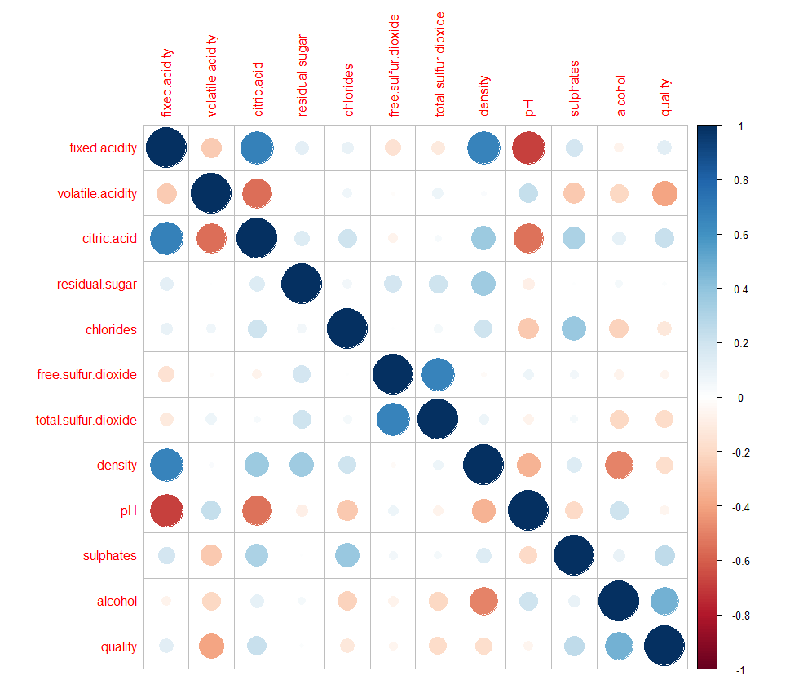
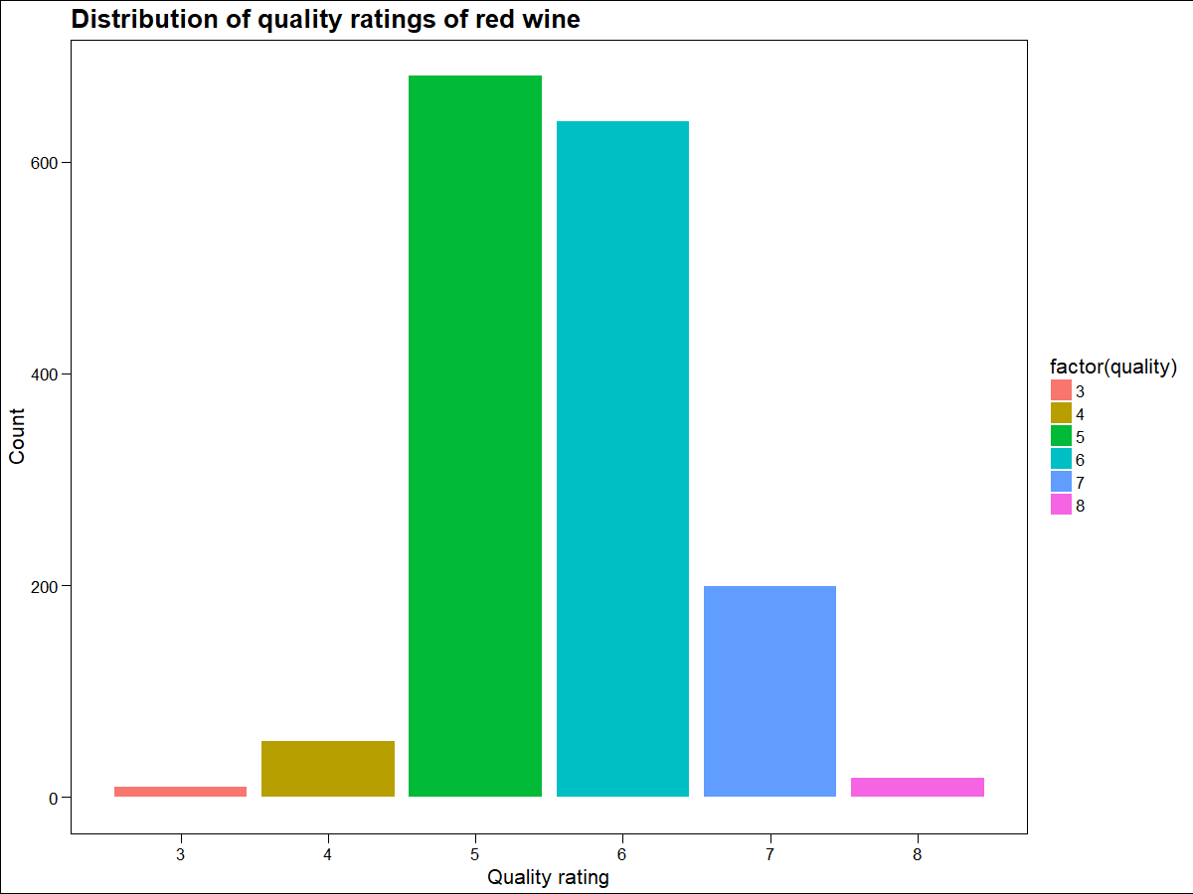
EDA for Regression
The distribution of wine quality ratings shows that most of the ratings are concentrated around 5 and 6
Volatile Acidity and Alcohol have high correlation with Quality – There is a good chance these will be the most important variables in our model
We can also see a number of highly correlated independent variables (Multi-collinearity): Fixed Acidity and Volatile Acidity, Fixed Acidity and Density, Fixed Acidity and pH, Volatile Acidity and Citric Acid, Citric Acid and pH, Free Sulfur Dioxide and Total Sulfur Dioxide and Density and Alcohol.

Slide 10
Regression

Slide 11
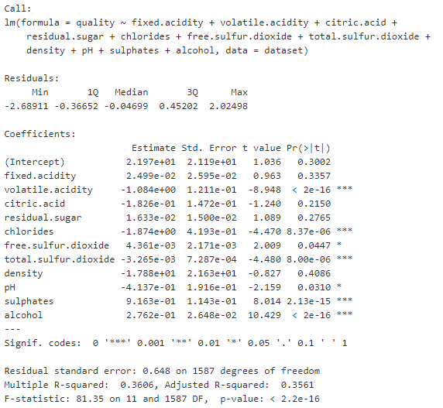
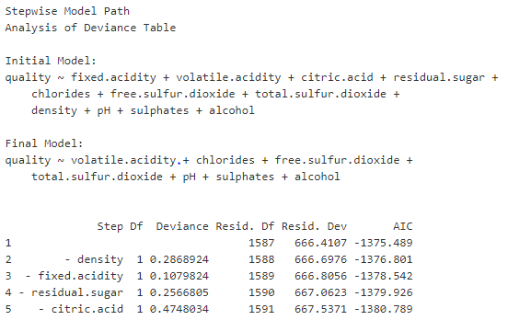
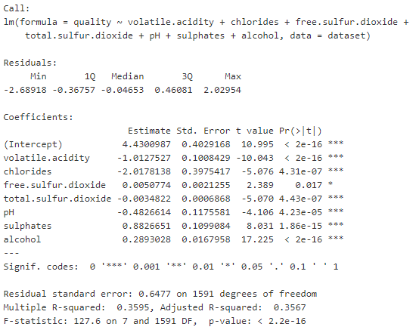
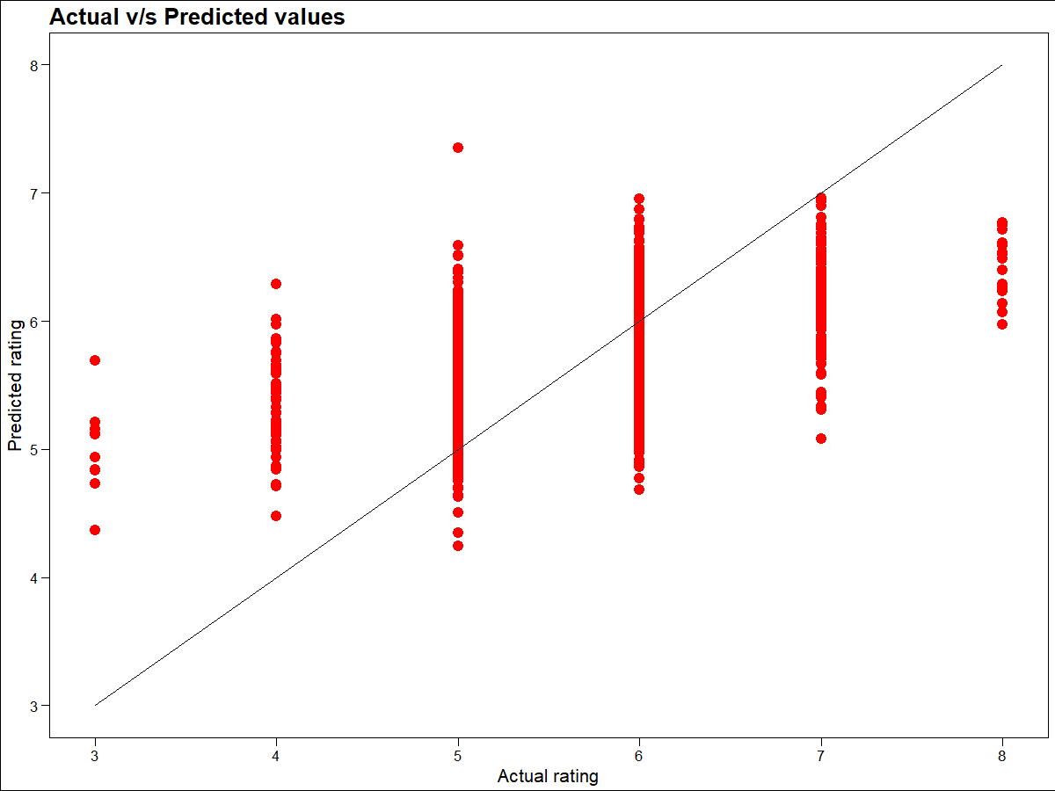
Linear Regression
We started with linear regression using all the variables
Next a stepwise model to remove insignificant variables
No Real Improvement
Improved adjusted R-square: 35.67%
Removed insignificant variables

Slide 12
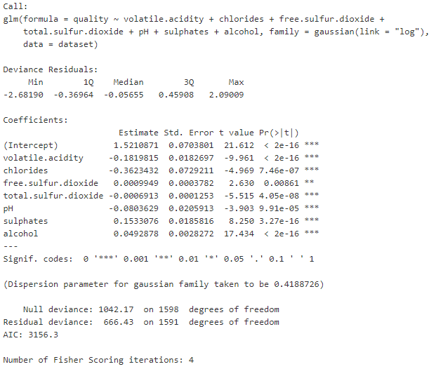
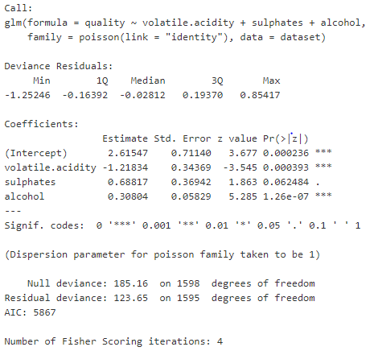
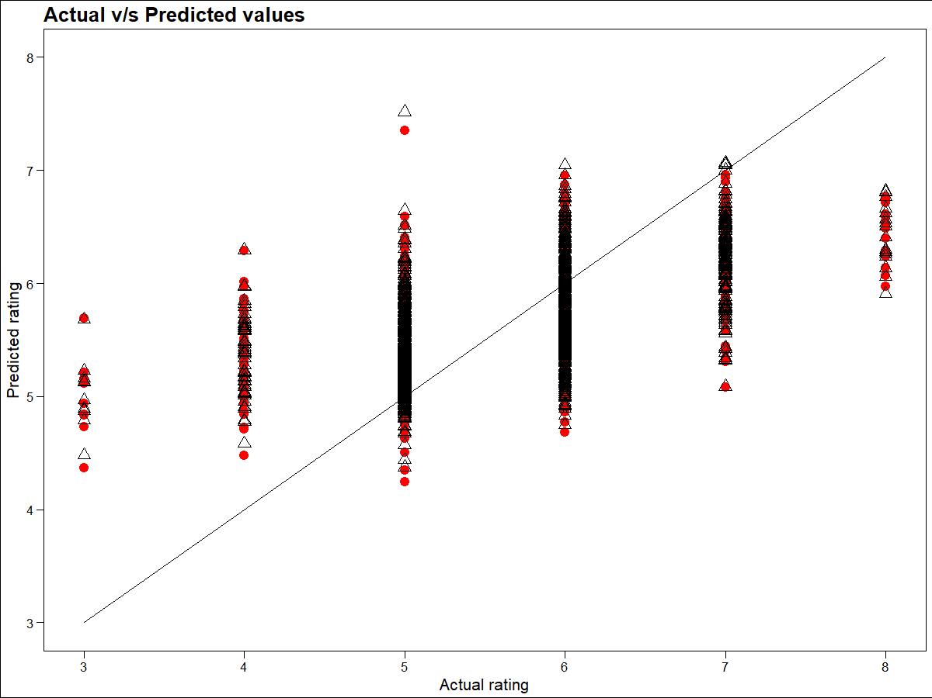
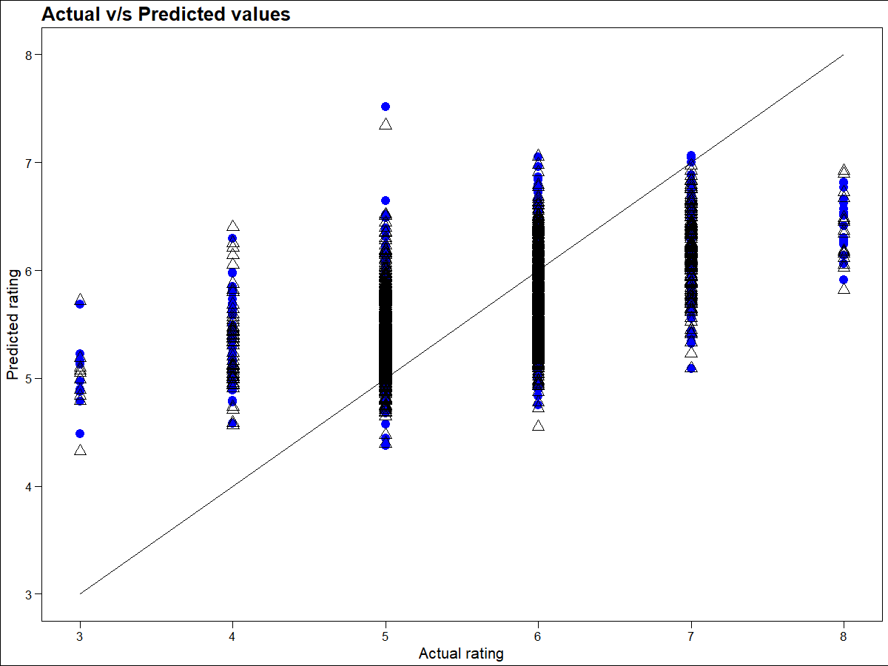
GLM
Let’s try a GLM model (Gaussian family, Log Link)
Another GLM model (Poisson family, Identity Link)
No Real Improvement

Slide 13
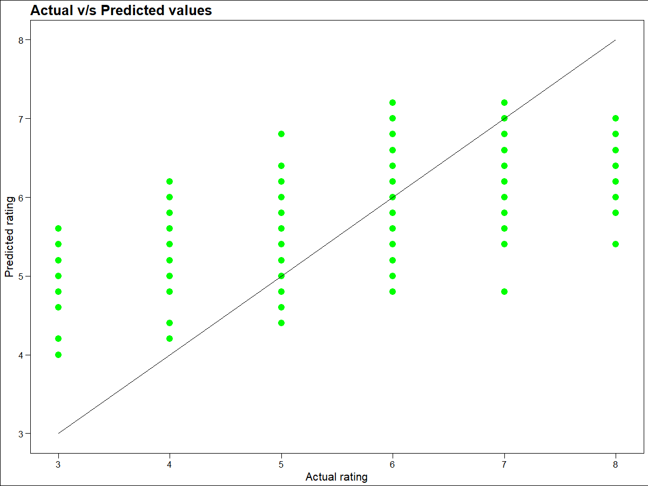
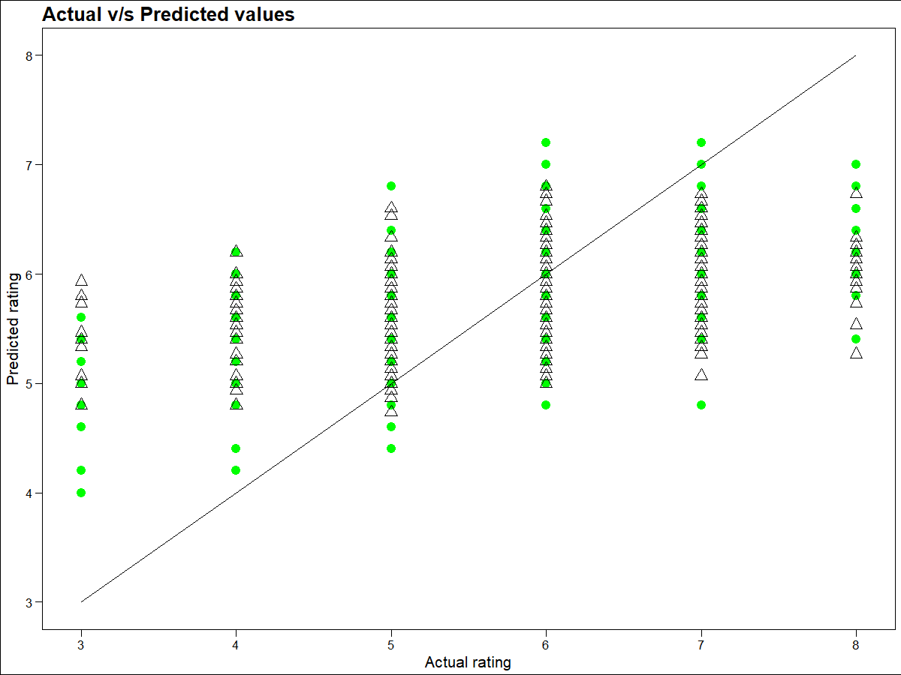
KNN Regression
Let’s try a KNN model with 5 neighbors
Another KNN model with 15 neighbors
No Real Improvement
None of the linear models give good fit
None of these models really give a good fit because there is very low variability among the physicochemical characteristics between individual wine ratings.
Models with such bad will not really solve the business problem – To help wine makers produce the best quality wine.
Let’s change our approach and view this as a classification problem.
Since ratings vary from 3-8, 7 and 8 can be regarded as good quality wines, what wine makers will probably try to achieve with their new wines.
Next, we try out classification models for good wines (7 and 8) vs others

Slide 14
Classification

Slide 15
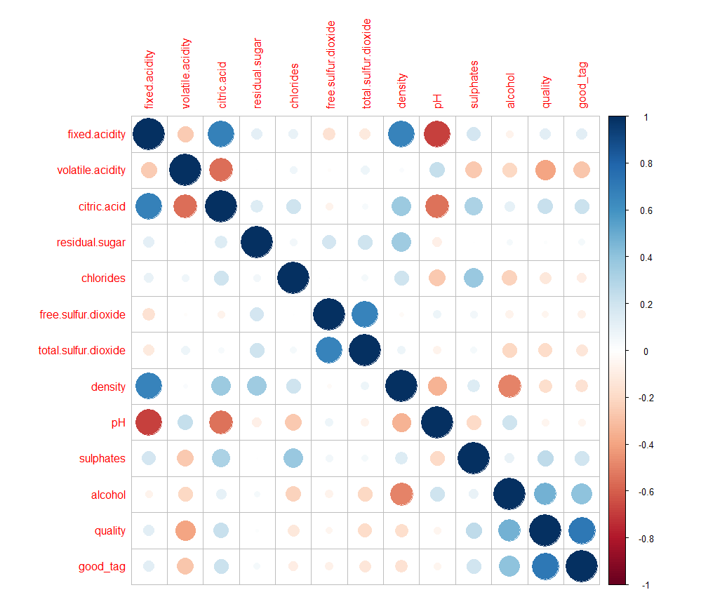
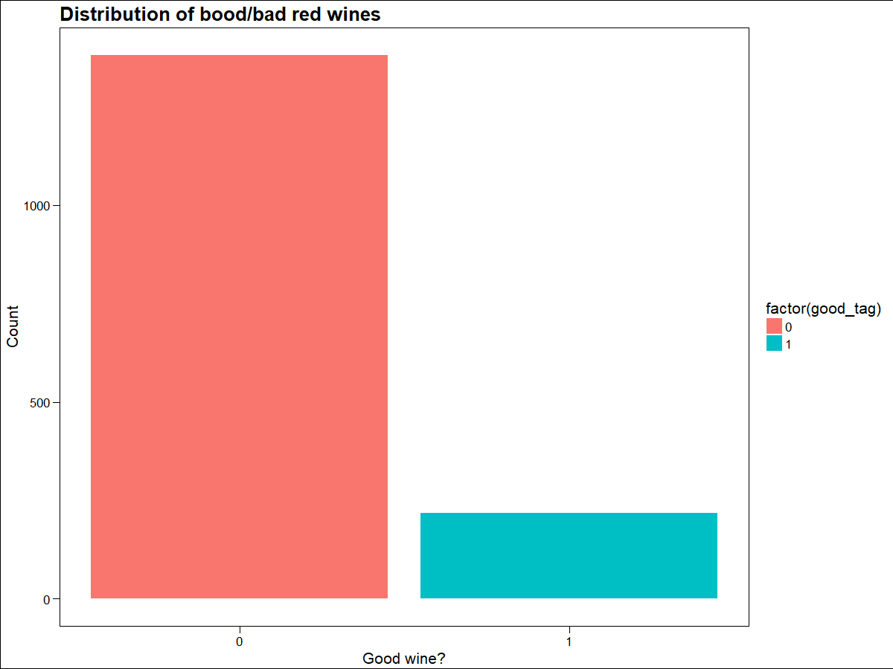
EDA for Classification
After splitting the dataset into good and bad wines, we see that the number of good wines is much lesser than the number of bad wines.
This indicates that any model that we make will be better at predicting bad quality wines than good quality wines.
This shouldn’t be much of a problem though.
The correlation plot is very similar to that of the correlation plot for regression where our target variable was quality
It looks like alcohol will be the most important variable in predicting the dependent variable good_tag.

Slide 16
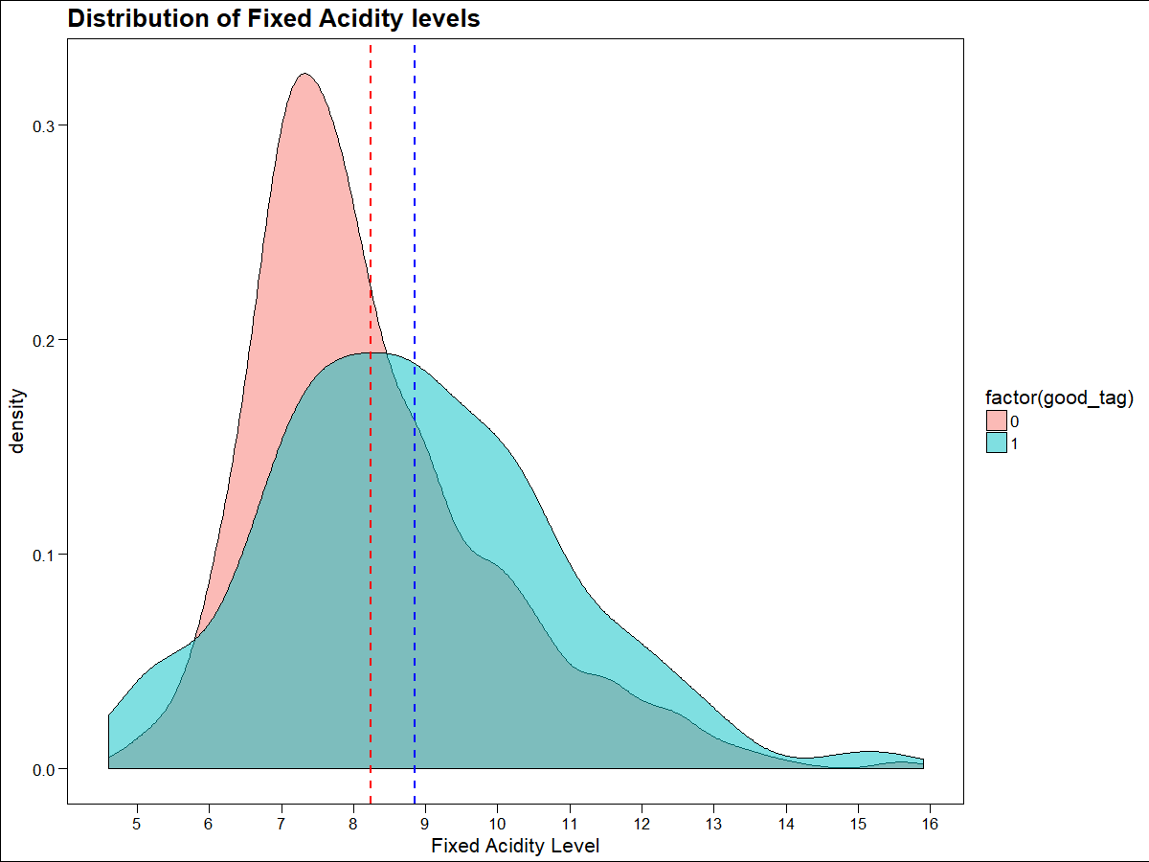
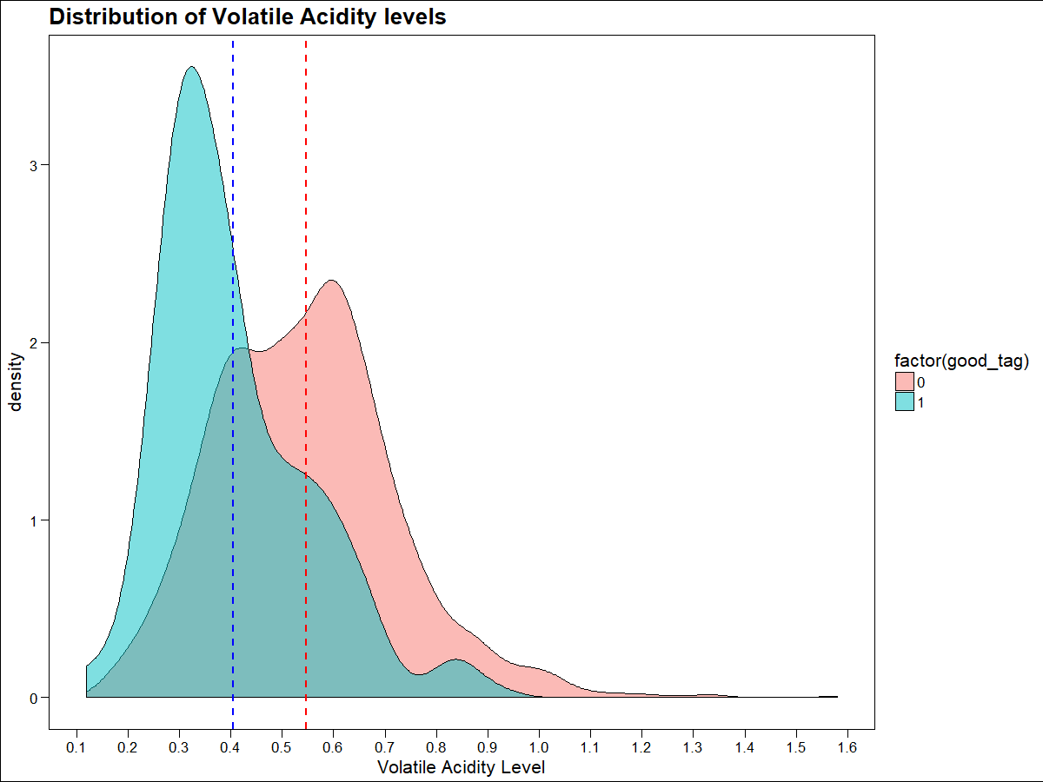
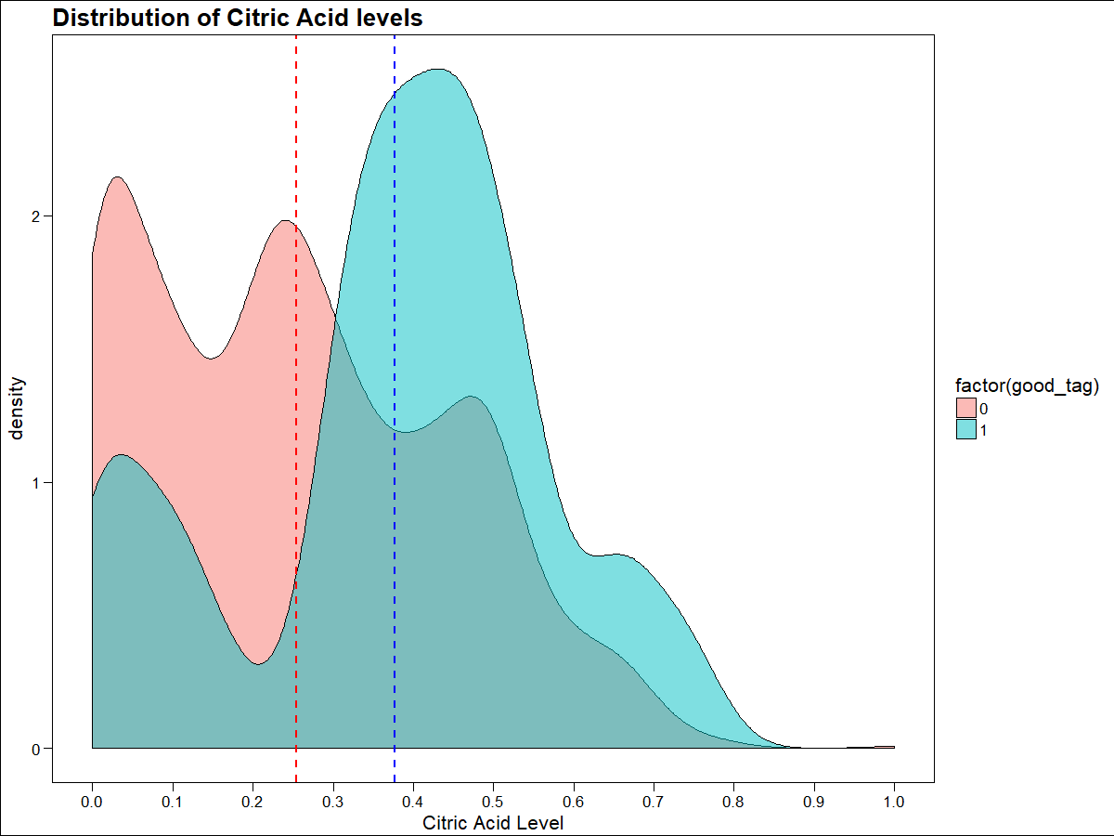
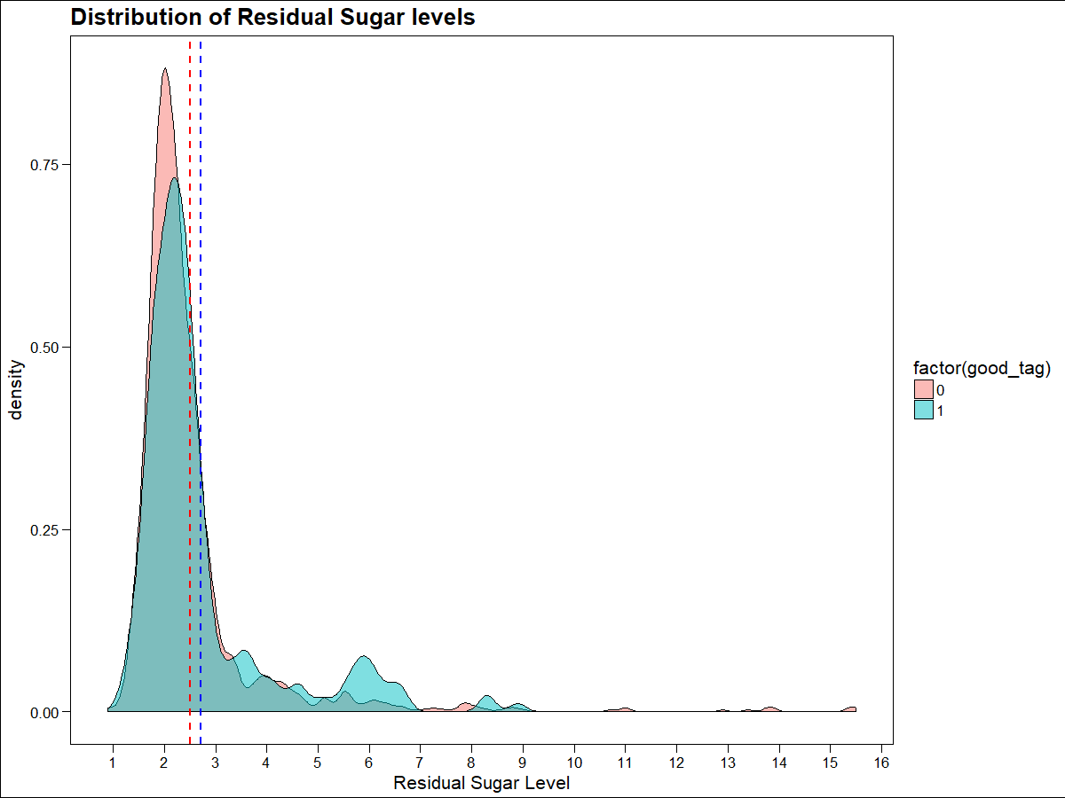
EDA for Classification
Volatile Acidity might be important in predicting whether a wine is of good/bad quality

Slide 17
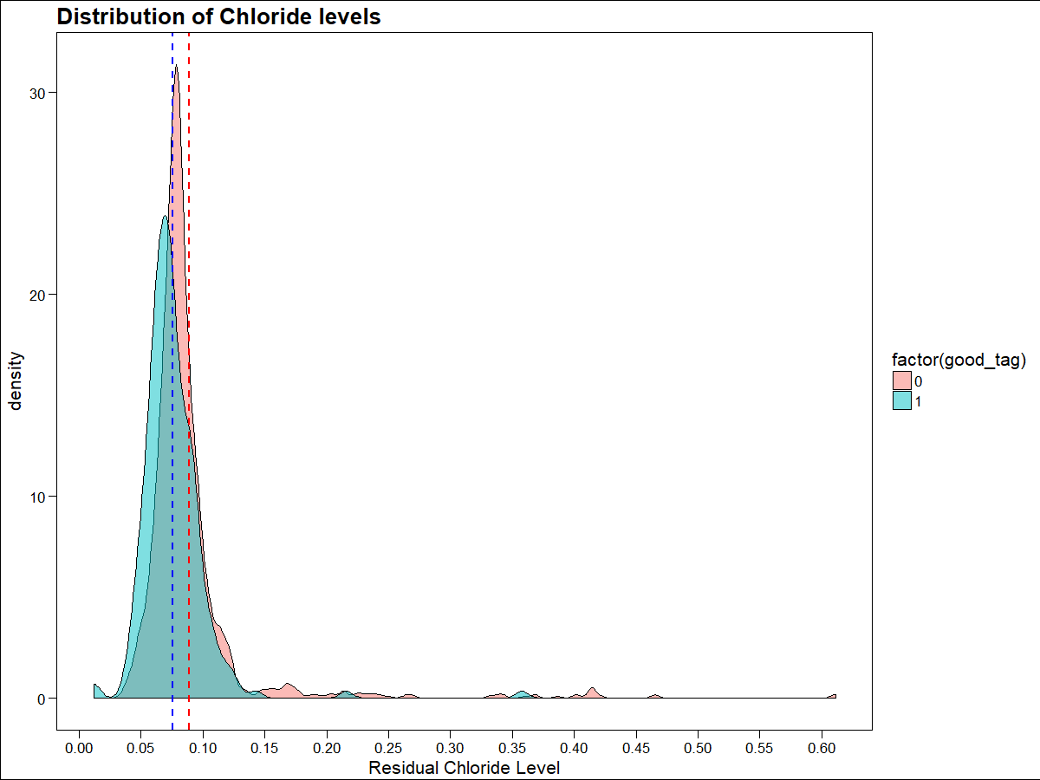
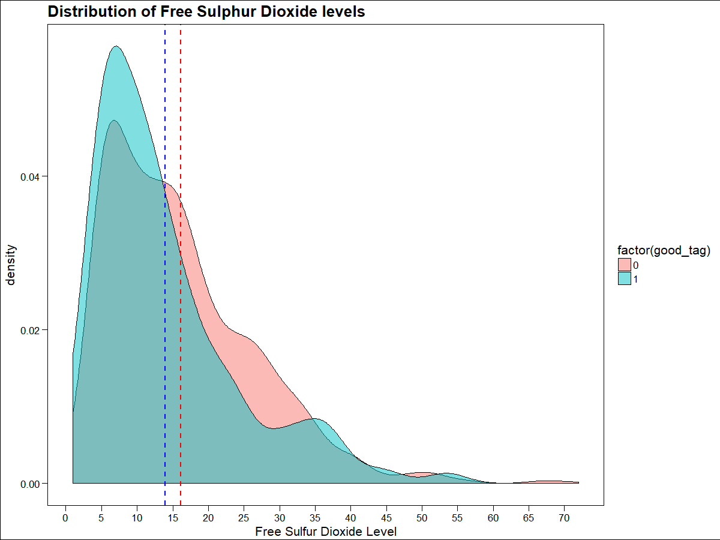
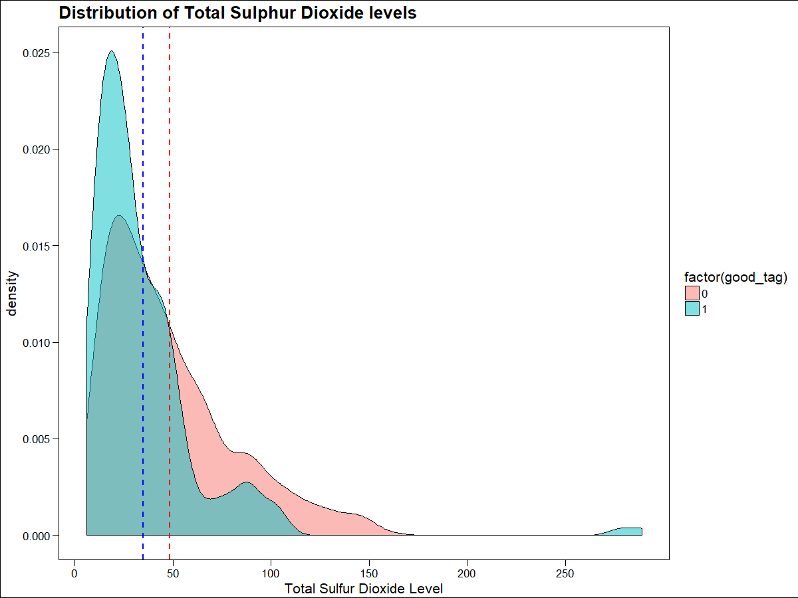
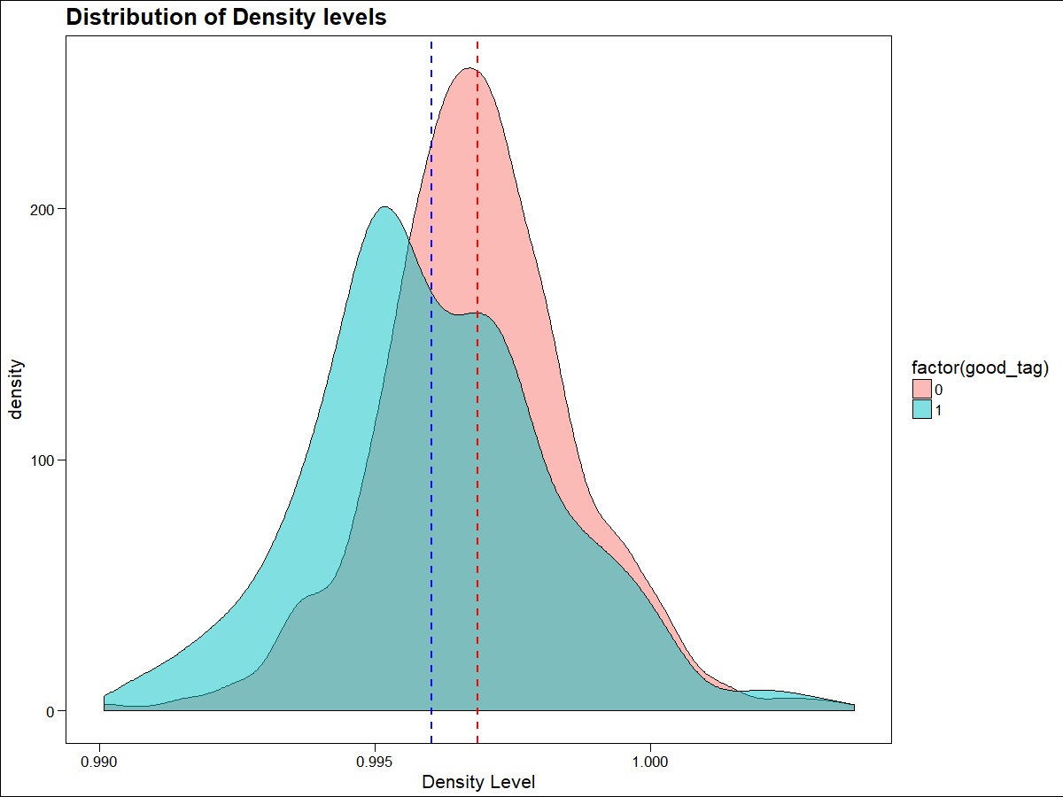
EDA for Classification
Density might be important in predicting whether a wine is of good/bad quality

Slide 18
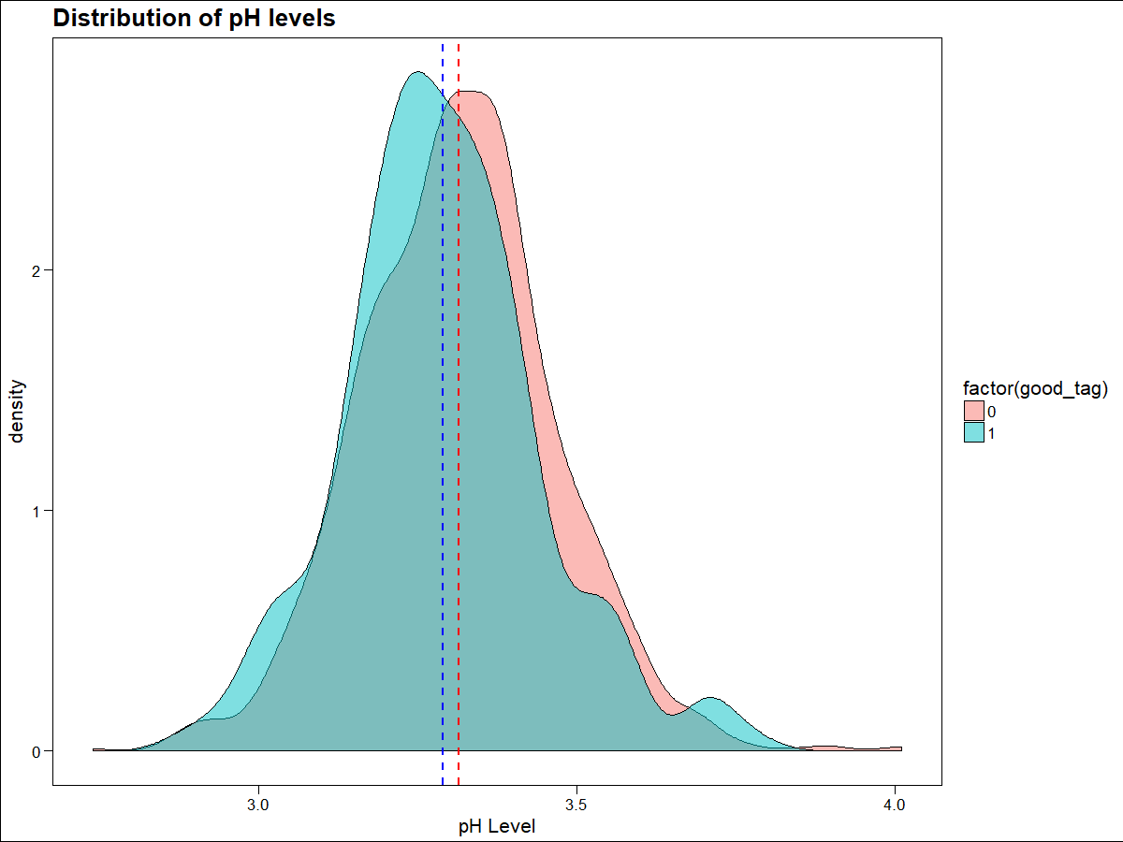
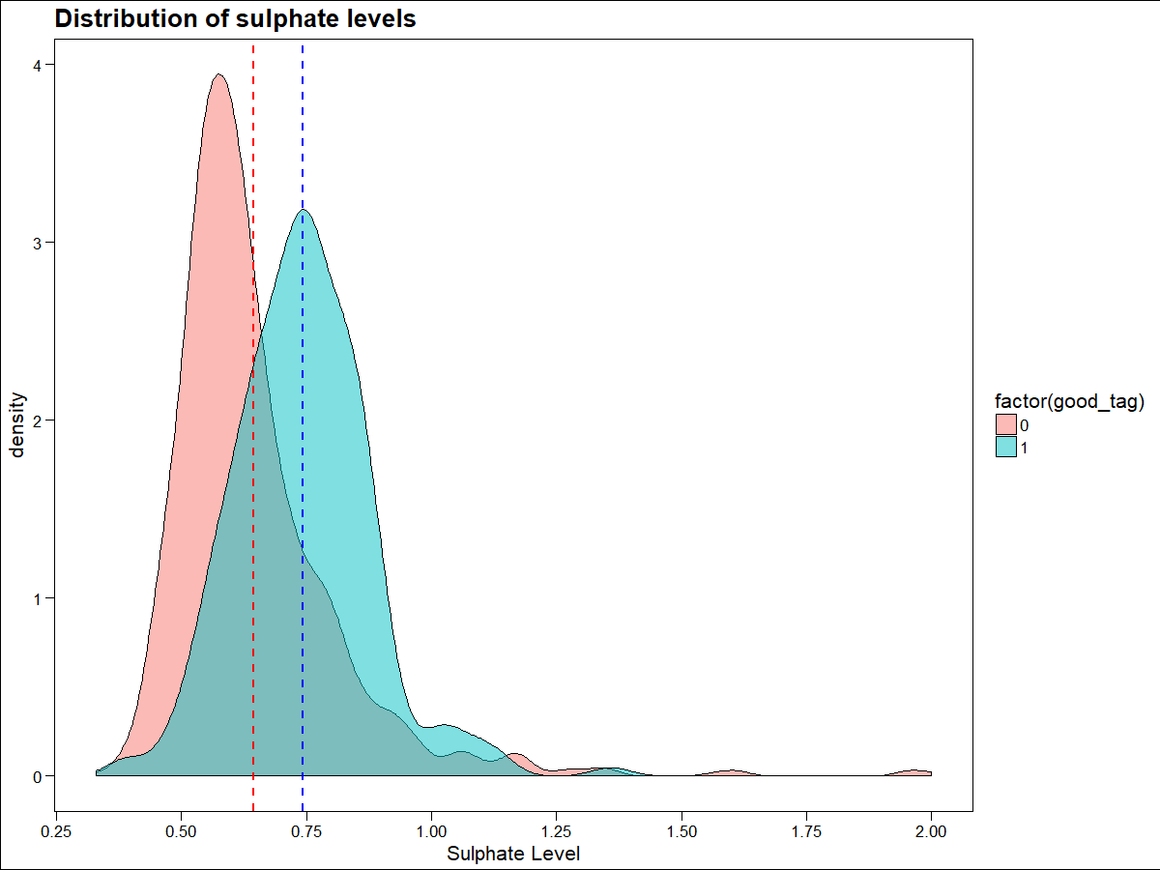
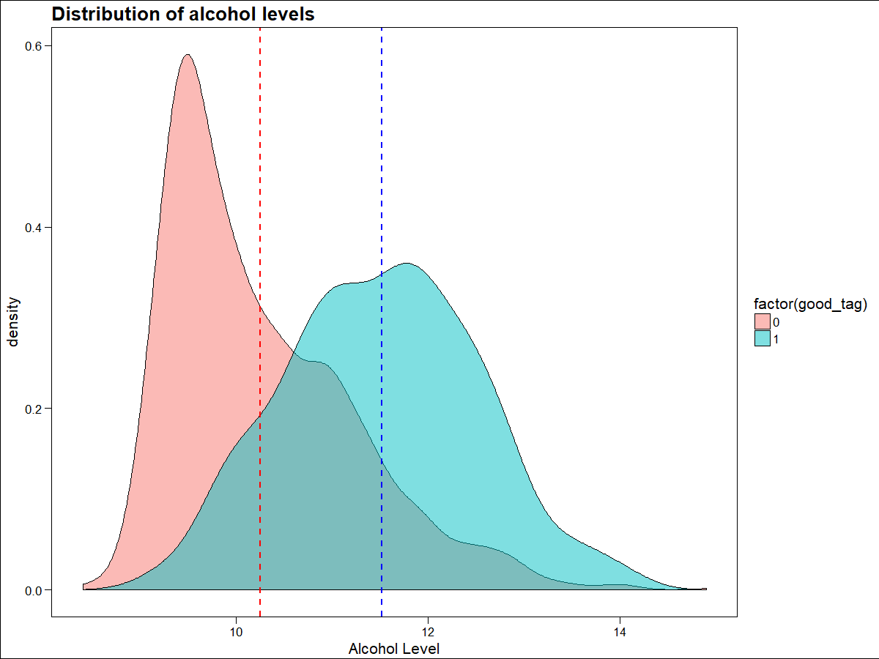
EDA for Classification
Both alcohol and sulphate levels might be important in predicting whether a wine is of good/bad quality

Slide 19
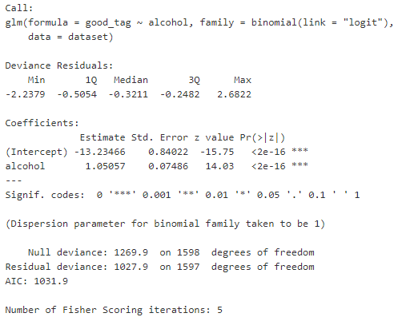
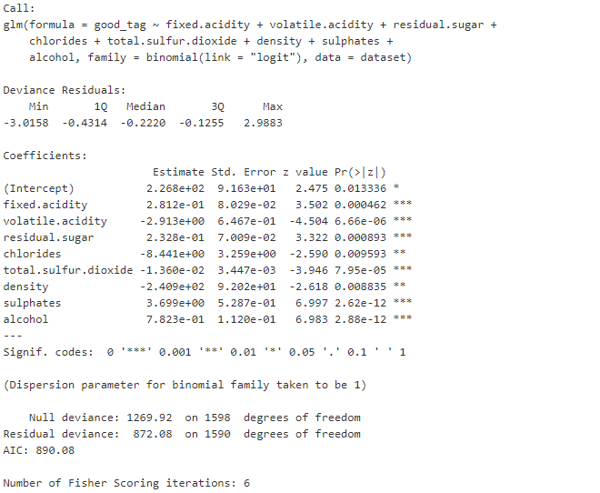
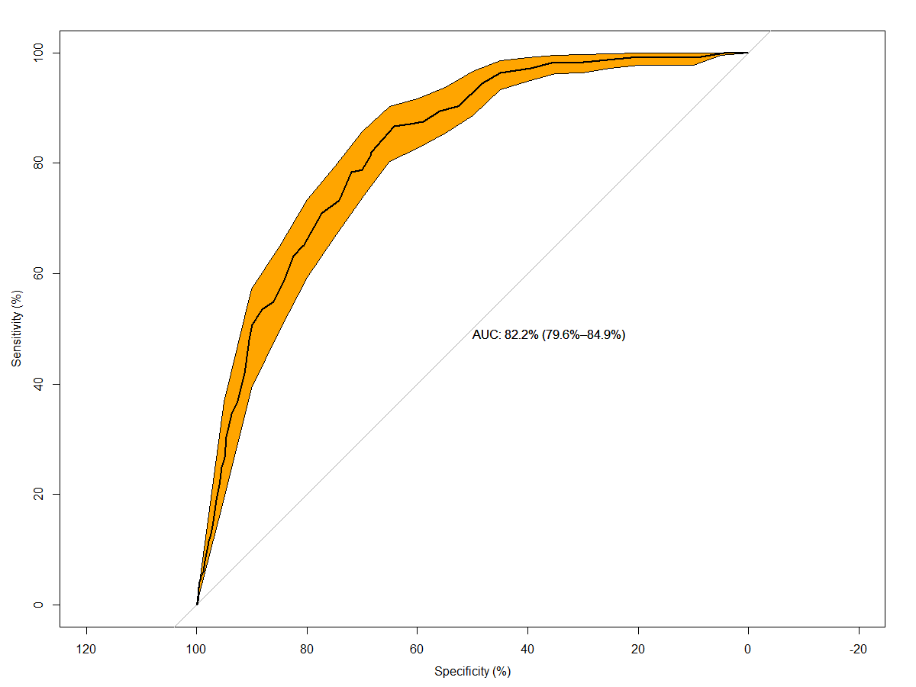
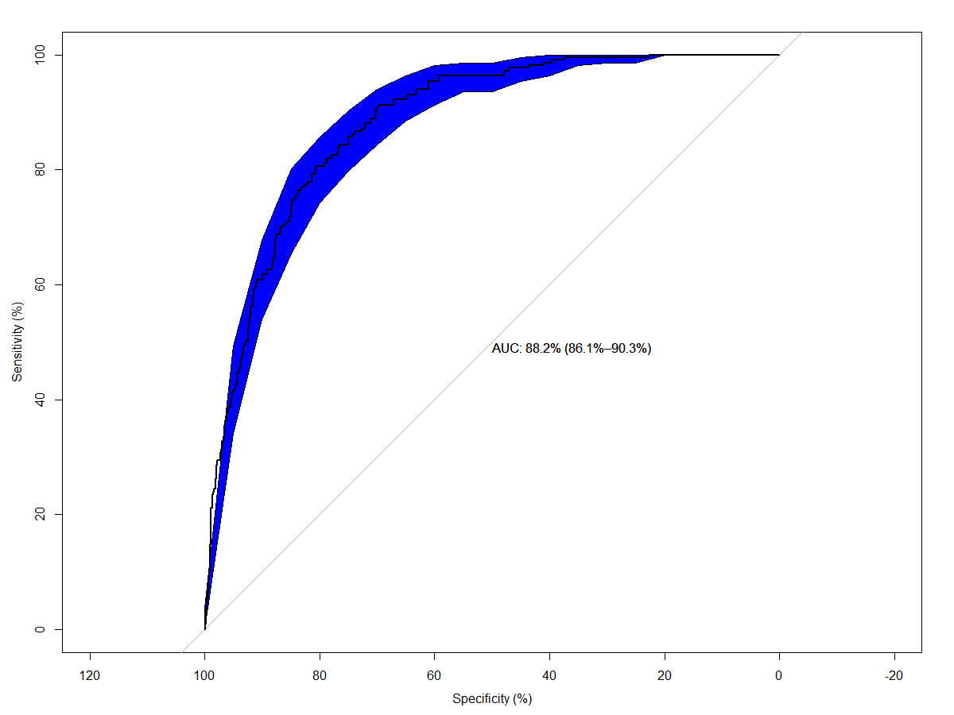
Logistic Regression
Let’s try a logistic regression model with just alcohol
Stepwise logistic regression model with all variables
Excellent Models

Slide 20
KNN Classifier
KNN Model with 20 neighbors
Confusion Matrix | Pred. Bad | Pred. Good
Actual Bad | 1378 | 4
Actual Good | 204 | 13
Excellent Model: Classification error rate of just 13%
KNN Model with 10 neighbors
Confusion Matrix | Pred. Bad | Pred. Good
Actual Bad | 1368 | 14
Actual Good | 185 | 32
Excellent Model: Classification error rate of just 12.44%
These models are clearly better than the logistic regression model

Slide 21
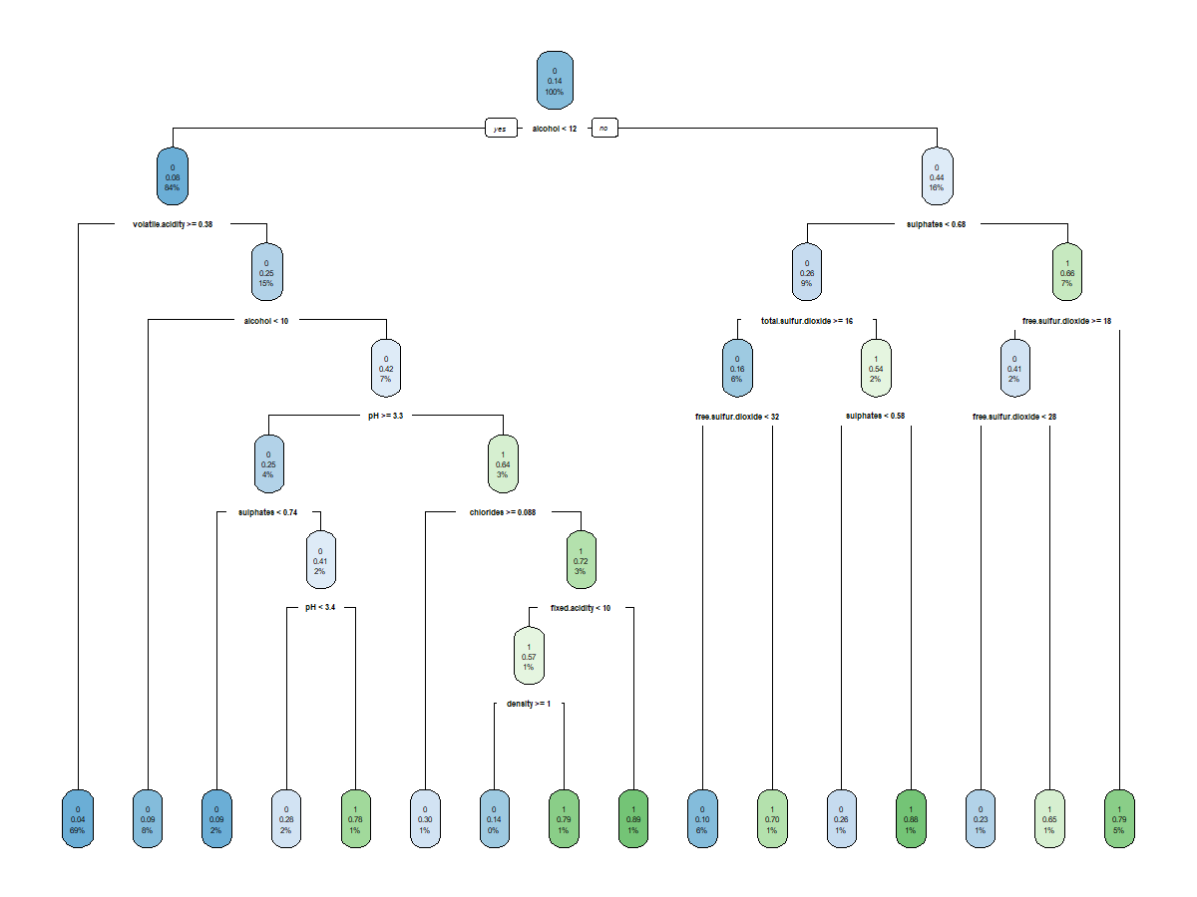
Decision Tree
Confusion Matrix | Pred. Bad | Pred. Good
Actual Bad | 1348 | 34
Actual Good | 91 | 126
Excellent Model: Classification error rate of just 7.817%
Decision tree model is even better than the KKN model

Slide 22
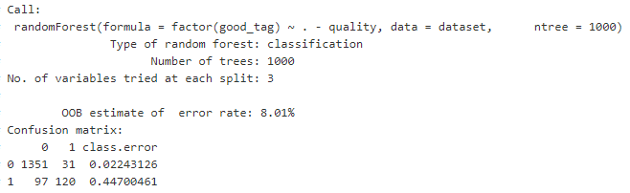
Random Forest
Confusion Matrix | Pred. Bad | Pred. Good
Actual Bad | 1351 | 31
Actual Good | 97 | 120
Excellent Model: Classification error rate of just 8.01%
This is a better model than the decision tree model since it is an ensemble model, which combines 1000 decision trees and takes their average result.
Despite having a higher classification error rate this model does a great job of not over-fitting the training dataset.

Slide 23
Implementation

Slide 24
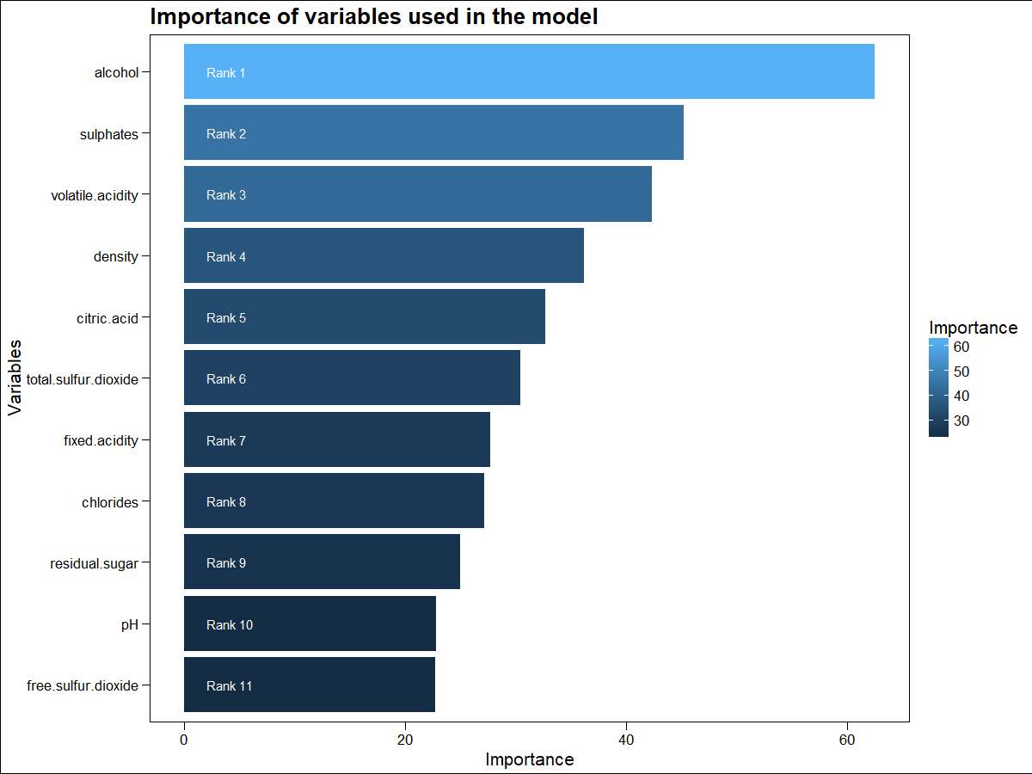
Implementation
This was meant to be an exploration of which model best fits our data.
Since we haven’t used training and test datasets, we can say that our models are kind of over-fitted to our dataset.
For true implementation, we should build the random forest model using test and training datasets and also try testing on new samples.
Once finalized a platform needs to be built, through which wine makers can input the physicochemical characteristics for their planned wine production schedule and they can know in advance how it will mostly liked be rated by CVRVV.
The model should also be adjusted from time-to-time as new data becomes available.
As predicted in the beginning the most important variable in our model is alcohol

Slide 25


Want big impact?
USE BIG IMAGE.

